Slide 1
Lecture 26
Errors, CIs, the sign test

Slide 2
Review
1 What is a simple hypothesis?
one that names a single value of the parameter, such as H₀: θ = θ₀
2 What is a composite hypothesis?
one that allows a range of values, such as H₀: θ ≤ θ₀ or H₀: θ ≥ θ₀
3 Where do we test a composite null?
at its boundary θ₀, the value in H₀ that is hardest to reject

Slide 3
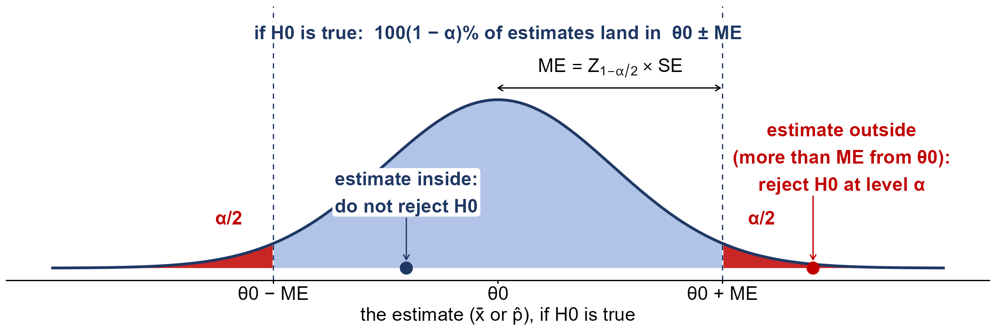
Confidence intervals and two-sided tests
the estimate is more than ME = Z_{1−α/2} × SE from θ₀: reject H₀ at level α
the same as: θ₀ lies outside the 100(1 − α)% CI, estimate ± ME

Slide 4
Types of errors
Type I error
reject H₀ when it is true: a false alarm; P(Type I error) = α
Type II error
do not reject H₀ when it is false: a missed effect; P(Type II error) = β
power
reject H₀ when it is false: power = 1 − β
α and β
for a fixed n, making one smaller makes the other larger

Slide 5
Decisions and the truth
 | H₀ is true | H₀ is false
Reject H₀ | Type I error false positive probability α | Correct decision true positive probability 1 − β = power
Do not reject H₀ | Correct decision true negative probability 1 − α | Type II error false negative probability β

Slide 6
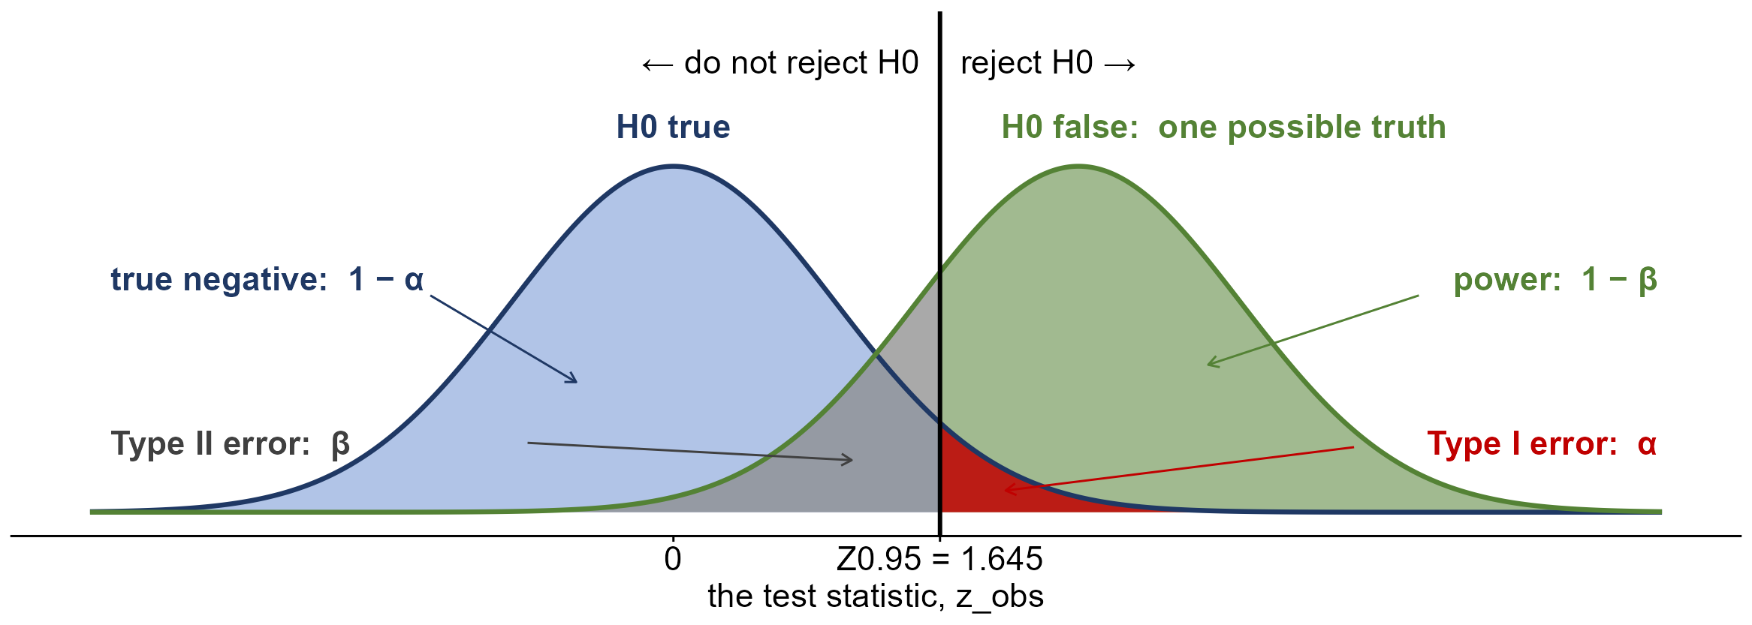
Errors and power on the distributions

Slide 7
Errors in context: climbing equipment
Before a climb, Navah inspects her ropes, harness and anchors. She has used the gear before, so she assumes it is safe, and retires it only if the inspection gives strong evidence that it is not. (OpenStax, Example 9.5)
H₀: Navah’s rock climbing equipment is safe
(a) Describe a Type I error in context.
(b) Describe a Type II error in context.
(c) Which error has the greater consequence?
(a) Navah thinks her equipment may not be safe when it really is: she retires good gear
(b) Navah thinks her equipment is safe when it is not: she climbs on it
(c) Type II: unsafe gear can fail during the climb

Slide 8
Errors in context: Genetic Labs
A company called Genetic Labs claims its procedure raises the chance that a pregnancy results in a boy. Statisticians test the claim by comparing the share of boys born to its customers with the usual share. (OpenStax, Example 9.7)
H₀: Genetic Labs has no effect on the baby’s sex
(a) Describe a Type I error in context.
(b) Describe a Type II error in context.
(c) Which error has the greater consequence?
(a) we conclude Genetic Labs changes the odds when it has no effect
(b) we conclude it has no effect when it really does change the odds
(c) Type I: people would pay for a procedure that does nothing

Slide 9
Errors in context: a cure-rate claim
A drug company claims its experimental drug cures at least 75% of men with prostate cancer. Patients and doctors use that figure to choose a treatment, and a research group tests the claim. (OpenStax, Example 9.8)
H₀: p ≥ 0.75 H_{A}: p < 0.75
(a) Describe a Type I error in context.
(b) Describe a Type II error in context.
(c) Which error has the greater consequence?
(a) we conclude the cure rate is under 75% when it is not: patients may skip a drug that works
(b) we accept the 75% claim when the rate is lower: patients rely on a weaker drug
(c) Type II: the 75% claim drives the choice of treatment

Slide 10
Practice: cell phone owners
Marketers believe 92% of U.S. adults own a cell phone. A manufacturer thinks it is lower and surveys 200 adults. (OpenStax, Try It 9.18)
n = 200; 174 own a cell phone; p₀ = 0.92; α = 0.05
(a) What are H₀ and H_{A}? Is the sample large enough?
(b) What are p̂, the standard error and z_{obs}?
(c) What is the P-value? What is the decision?
(d) What are the Type I and Type II errors?
(a) H₀: p ≥ 0.92 H_{A}: p < 0.92; np₀ = 184, n(1 − p₀) = 16, both ≥ 15
(b) p̂ = 0.87; SE = √(0.92 × 0.08 / 200) ≈ 0.0192; z_{obs} ≈ −2.60
(c) P(Z ≤ −2.60 | p = 0.92) = 0.0047 < 0.05: reject H₀
(d) I: say fewer than 92% own one when 92%+ do. II: miss that fewer than 92% do

Slide 11
Statistical power
power
P(reject H₀ | H₀ false) = 1 − β
β
P(do not reject H₀ | H₀ false): the chance of missing the effect
power depends on the truth
it is computed at one assumed true value of the parameter
low power
a real effect is easily missed: “do not reject” is not “H₀ is true”

Slide 12
Example: power for the goggles
Jeffrey’s mean 25-yard freestyle time is 16.43 s, with σ = 0.8. Suppose new goggles really cut his mean to 16.0 s. (OpenStax, Example 9.14)
n = 15; σ = 0.8 s; μ₀ = 16.43; true μ = 16.0; α = 0.05
(a) H_{A}: μ < 16.43. Below what sample mean does the test reject H₀?
(b) If the true mean is 16.0, what is the power?
(c) What is β? What does it mean?
(a) SE = 0.8 / √15 ≈ 0.2066; reject if x̄ ≤ 16.43 − 1.645(0.2066) ≈ 16.09
(b) P(x̄ ≤ 16.09 | μ = 16.0) = P(Z ≤ (16.09 − 16.0) / 0.2066) = P(Z ≤ 0.44) = 0.67
(c) β = 1 − 0.67 = 0.33: a third of the time, the test misses the goggles working

Slide 13
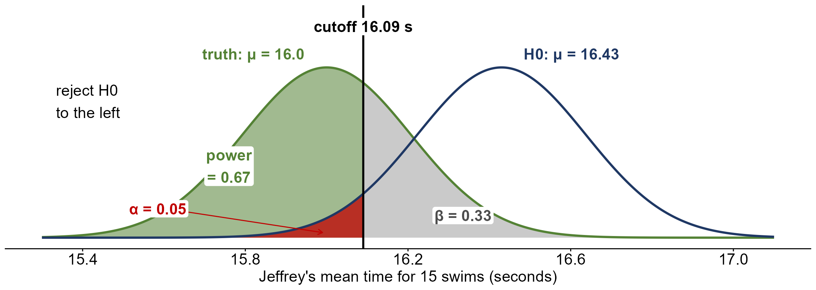
α, β and power

Slide 14
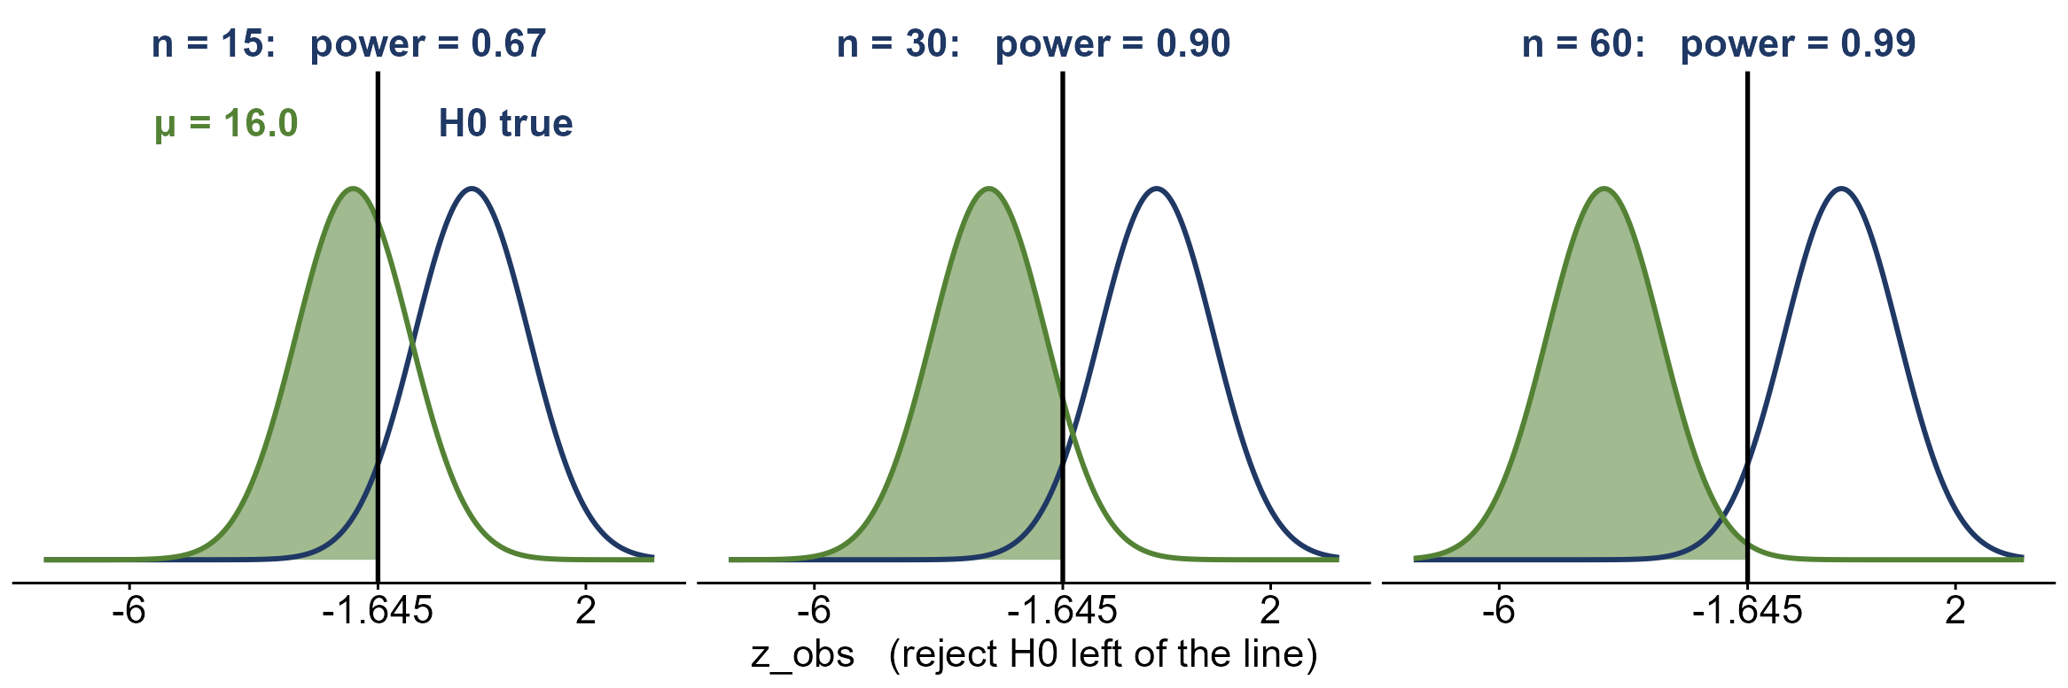
Power and the test statistic as n grows
the null curve and the cutoff stay put; as n grows, z_{obs} for μ = 16.0 moves away from 0

Slide 15
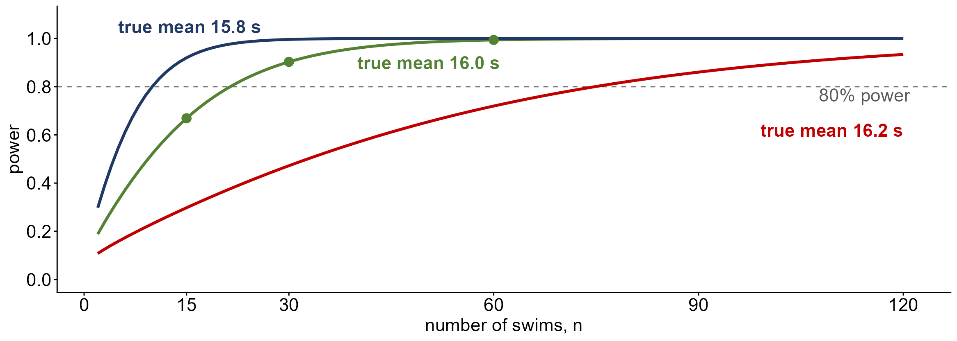
Power against sample size
with a true mean of 16.0 s, n = 22 swims give 80% power; for 16.2 s it takes n = 75

Slide 16
What raises the power?
more data: n = 30
power 0.67 → 0.90: a smaller SE pulls the two curves apart
a larger α = 0.10
power 0.67 → 0.79, but more Type I errors
a bigger effect: μ = 15.8 s
power 0.67 → 0.92: big effects are easier to detect
less variability
a smaller σ shrinks the SE, like a bigger n

Slide 17
Practice: testing water for E. coli
A microbiologist tests a water sample for E. coli before it is approved for drinking. Her test can raise a false alarm or miss bacteria that are there. (OpenStax, Section 9.2, Exercise 19)
H₀: the sample does not contain E. coli
(a) P(she thinks it has E. coli | it does not) = 0.012. Which error, and which letter?
(b) P(she thinks it is clean | it has E. coli) = 0.002. Which error, and which letter?
(c) What is the power of her test? What does it mean?
(a) a Type I error (a false alarm): α = 0.012
(b) a Type II error (a miss): β = 0.002
(c) power = 1 − β = 0.998: she detects E. coli 99.8% of the time it is there

Slide 18
Practice: is the patient sick?
A doctor runs a diagnostic test on a patient. Unless the test gives strong evidence of illness, the doctor treats the patient as healthy and sends them home. (OpenStax, Try It 9.6)
H₀: the patient is not sick
(a) Describe a Type I error in context.
(b) Describe a Type II error in context.
(c) Which error has the greater consequence?
(a) the doctor decides a healthy patient is sick: needless worry and treatment
(b) the doctor decides a sick patient is healthy: the patient goes home untreated
(c) Type II: a sick patient goes untreated

Slide 19
Assumptions of the tests so far
every test so far
a random sample (or randomized experiment) of independent observations
z-test for p
Y ~ Bernoulli(p), so the count is Binomial(n, p); np₀ ≥ 15 and n(1 − p₀) ≥ 15
z-test for μ (σ known)
the population is approximately normal, X ~ N(μ, σ), or n ≥ 30 (CLT)
t-test for μ (σ unknown)
the population is approximately normal, X ~ N(μ, σ), or n ≥ 30 (CLT)

Slide 20
When is a t-test a stretch?
Do husbands and wives see who decides the same way? 17 couples each rate who had more say in a recent major financial decision, from 1 (the wife) to 7 (the husband). Each spouse rates separately, and we look at husband − wife for each couple.
n = 17 couples; ratings 1 to 7; differences from −1 to 5
(a) What would a t-test on the differences assume?
(b) Is that believable here?
(c) What could we use instead?
(a) the differences are a sample from a normal population (or n is large)
(b) doubtful: n = 17 is small, and 1–7 ratings are crude, ordered scores
(c) a test that uses only whether each difference is + or −

Slide 21
Parametric vs non-parametric tests
parametric test
assumes a model for the population, such as X ~ N(μ, σ): the z- and t-tests
non-parametric test
makes few or no assumptions about the population’s distribution
advantages
works for small samples, skewed data, ranks and ratings; simple to compute
disadvantage
less power than the parametric test when that test’s assumptions hold

Slide 22
The sign test
what it tests
a population median; with matched pairs, the median difference M_{D}
the signs
write + or − for each difference; drop the zeros; n = the number left
the key fact
half of a population lies above its median: if M_{D} = 0, then P(+) = 0.5
the proportion
p = P(a difference is +): H₀: M_{D} = 0 is the same as H₀: p = 0.5

Slide 23
Sign test: the hypotheses
H₀: M_{D} = 0
p = 0.5: no systematic difference; + and − equally likely
H_{A}: M_{D} > 0
p > 0.5: upper-tailed; the first measurement tends to be larger
H_{A}: M_{D} < 0
p < 0.5: lower-tailed; the first measurement tends to be smaller
H_{A}: M_{D} ≠ 0
p ≠ 0.5: two-sided; a difference in either direction

Slide 24
Sign test: the test statistic
the test statistic
S = the number of + signs among the n non-zero differences
if H₀ is true
S ~ Binomial(n, 0.5): P(S = k) = n! / (k! (n − k)!) × 0.5^{n}
mean and SE
E(S) = n × 0.5 = n/2; SE(S) = √(n × 0.5 × 0.5) = √n / 2
large n (n/2 ≥ 15)
z_{obs} = (S − n/2) / (√n / 2) ~ N(0, 1): the z-test for p with p₀ = 0.5

Slide 25
Sign test: the P-value
H_{A}: M_{D} > 0 (p > 0.5)
P(S ≥ s | H₀ true): add the binomial probabilities from s up to n
H_{A}: M_{D} < 0 (p < 0.5)
P(S ≤ s | H₀ true): add the binomial probabilities from 0 up to s
H_{A}: M_{D} ≠ 0 (p ≠ 0.5)
2 × the smaller of the two tails
which table?
n/2 < 15: the exact binomial; n/2 ≥ 15: the z-table with z_{obs}

Slide 26
Data: who made the decision?
Couple | 1 | 2 | 3 | 4 | 5 | 6 | 7 | 8 | 9 | 10 | 11 | 12 | 13 | 14 | 15 | 16 | 17
Husband | 5 | 4 | 6 | 6 | 3 | 2 | 5 | 3 | 1 | 4 | 5 | 4 | 4 | 7 | 5 | 5 | 5
Wife | 3 | 3 | 4 | 5 | 3 | 3 | 2 | 3 | 2 | 3 | 2 | 2 | 5 | 2 | 5 | 3 | 1
Difference | 2 | 1 | 2 | 1 | 0 | −1 | 3 | 0 | −1 | 1 | 3 | 2 | −1 | 5 | 0 | 2 | 4
Ratings: 1 = the wife had more say, 7 = the husband had more say. Difference = husband − wife, so + means the husband saw himself as having more say.

Slide 27
Example: who made the decision?
Is there a systematic difference in how husbands and wives see a major financial decision? For each of the 17 couples, the difference is the husband’s rating minus the wife’s.
2, 1, 2, 1, 0, −1, 3, 0, −1, 1, 3, 2, −1, 5, 0, 2, 4; α = 0.05
(a) How many + and − signs are there? What are n and S?
(b) State H₀ and H_{A} in context.
(c) If H₀ is true, what are E(S) and SE(S)? Can we use z?
(d) Find the P-value. What is the decision?
(a) 11 plus, 3 minus, 3 zeros dropped: n = 14, S = 11
(b) M_{D} = median of husband − wife: H₀: M_{D} = 0 (p = 0.5), H_{A}: M_{D} ≠ 0
(c) E(S) = 7, SE(S) = √14 / 2 ≈ 1.87; n/2 = 7 < 15: use the exact binomial
(d) 2 × P(S ≥ 11) = 2 × 0.0287 = 0.0574 > 0.05: do not reject H₀

Slide 28
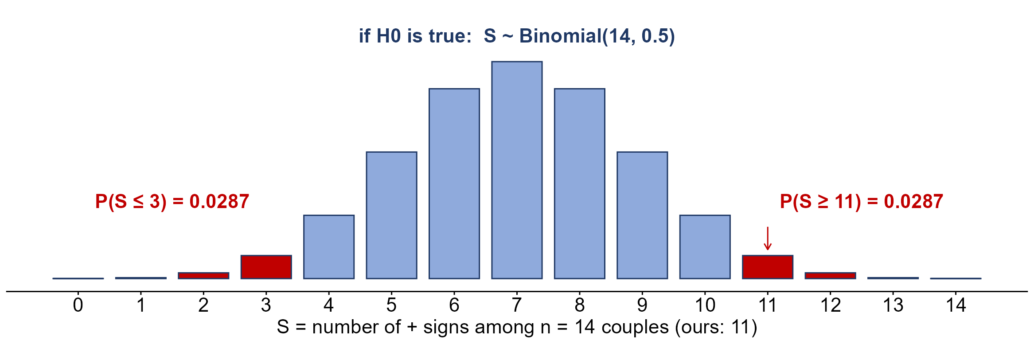
The sign test’s P-value
P(S ≥ 11) = [C(14, 11) + C(14, 12) + C(14, 13) + C(14, 14)] / 2¹⁴ = 470 / 16,384 = 0.0287
two-sided: P-value = 2 × 0.0287 = 0.0574

Slide 29
Practice: a stretching program
A physical therapist thinks a six-week stretching program lowers knee pain. Ten patients rate their pain from 0 to 10 before and after the program; the difference is before − after, so + means less pain. (hypothetical data)
3, 1, 0, 2, 4, −1, 2, 1, 3, 2; α = 0.05
(a) How many + and − signs are there? What is n?
(b) State H₀ and H_{A}.
(c) Find the P-value.
(d) What is the decision?
(a) 8 plus, 1 minus, 1 zero dropped: n = 9, S = 8
(b) H₀: M_{D} = 0 H_{A}: M_{D} > 0 (upper-tailed; p > 0.5)
(c) P(S ≥ 8) = (9 + 1) / 512 ≈ 0.0195
(d) 0.0195 < 0.05: reject H₀; the program appears to lower pain

Slide 30
Practice: a new coffee blend
A coffee shop thinks its regulars prefer a new blend. 60 regular customers each rate the old and the new blend from 1 to 10; the difference is new − old. 38 are +, 16 are −, and 6 are ties. (hypothetical data)
n = 60 customers; 38 +, 16 −, 6 ties; α = 0.05
(a) What are n and S?
(b) State H₀ and H_{A}.
(c) Find E(S), SE(S) and z_{obs}. Why may we use z here?
(d) Find the P-value. What is the decision?
(a) drop the 6 ties: n = 54, S = 38
(b) H₀: M_{D} = 0 H_{A}: M_{D} > 0 (upper-tailed; p > 0.5)
(c) E(S) = 27, SE(S) = √54 / 2 ≈ 3.674; n/2 = 27 ≥ 15; z_{obs} = (38 − 27) / 3.674 ≈ 2.99
(d) P(Z ≥ 2.99) = 1 − 0.9986 = 0.0014 < 0.05: reject H₀

